Slide 1



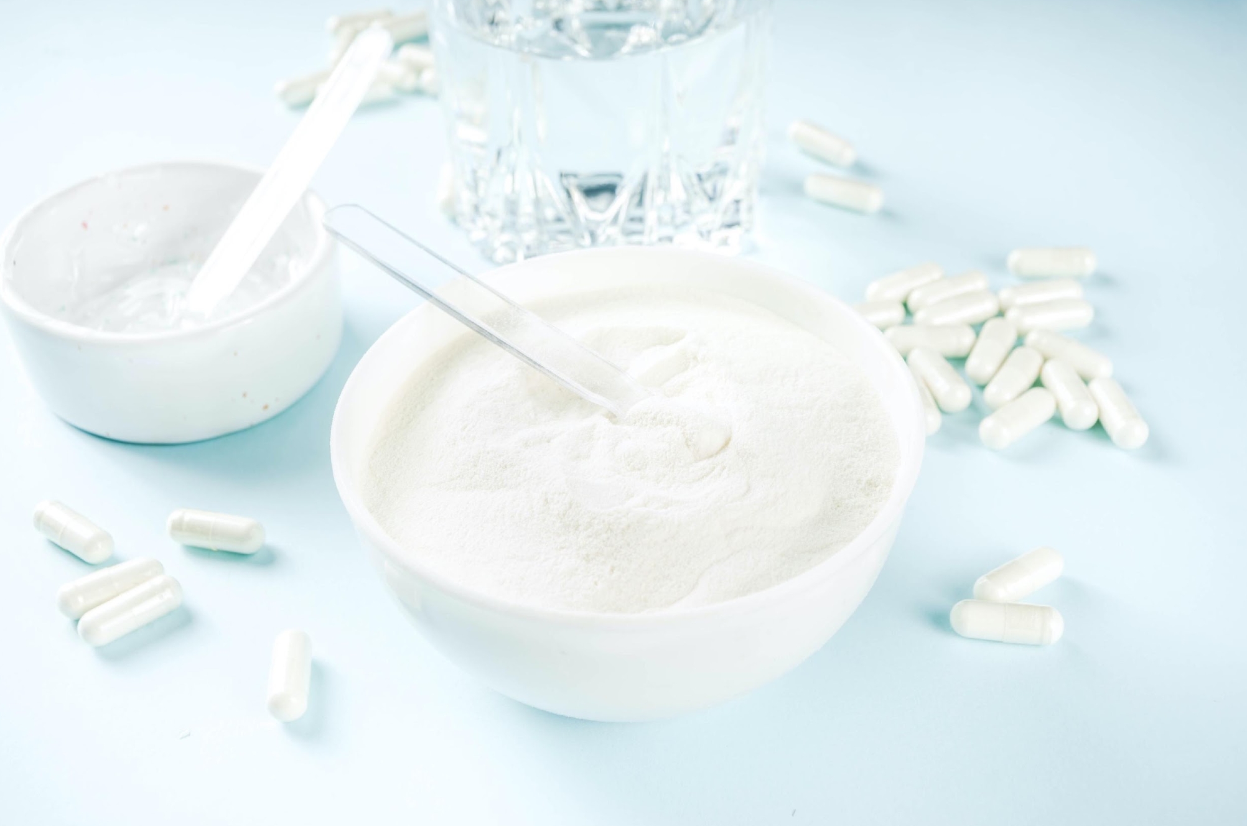

About The Collagen Stewardship Alliance

Slide 2




Our Core Team
Len Monheit
CEO, Industry Transparency Center
Steve Imgrund
Communications Director, Industry Transparency Center
Maggie Feikes
Project Specialist, Industry Transparency Center

Slide 3

Our Mission:
To promote the collagen category worldwide and steward responsible, sustainable growth.
The Need for CSA:
The Collagen Stewardship Alliance provides an objective voice raising awareness of collagen and its benefits, tracking data and insights, reaching out to a broad range of associations, academia and media, and working with government groups, the healthcare community and the industry – globally.

Slide 4

Objectives:
Create a central point of contact and hub for the collagen category, that drives global standards and brings growth for alliance members.
To steward responsible and sustainable growth of the global collagen category, ensuring responsible companies are celebrated and those who seek to exploit the category are not rewarded.
Engage and educate consumers, media and other stakeholders on collagen, providing a unified front and megaphone for good science, ingredients and products.

Slide 5
Initiatives:
Promote and attribute the science supporting collagen
Promote product quality and appropriate testing
Be an objective industry voice for collagen and collagen containing products, to consumers, government, retailers and healthcare professionals
Interact with trade and consumer media to promote greater awareness of collagen
Work with academia and research organizations for clinical scientific projects
Present data and insights on collagen ingredient, products and the category

Slide 6








Current Verified Ingredients:

Slide 7



COLLAGEN 101
A GUIDE FOR CLINICIANS AND INDUSTRY PROFESSIONALS
Presented by:

Slide 8
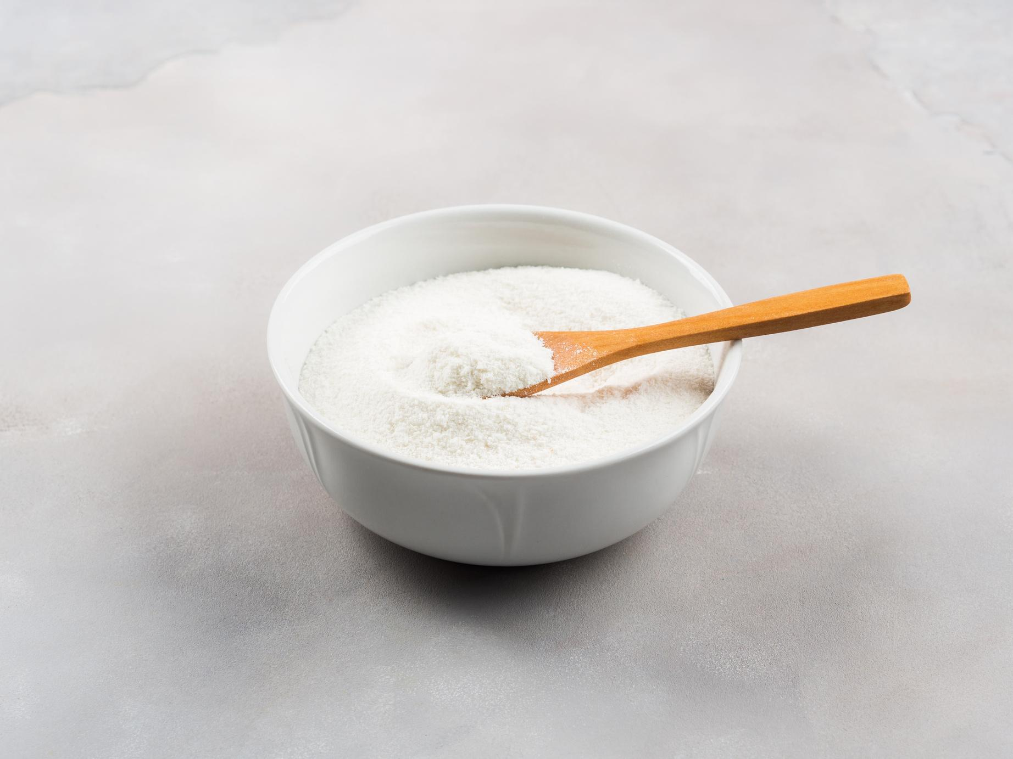
VEGAN COLLAGEN CONUNDRUM
We support the following position:
We advocate for transparency in all communications, particularly with companies making collagen ‘animal-identical molecules’, suggesting that industry does not use a vegan claim in reference to those products. We do this to protect the integrity of the term for vegans who avoid animal products in the interest of their health. While it may be fair to call products vegan in terms of the processing, it is misleading to call it vegan in terms of the actual physical properties of the product itself because, by definition, collagen is an animal protein. Such products should be revised to “animal-free collagen”.

Slide 9

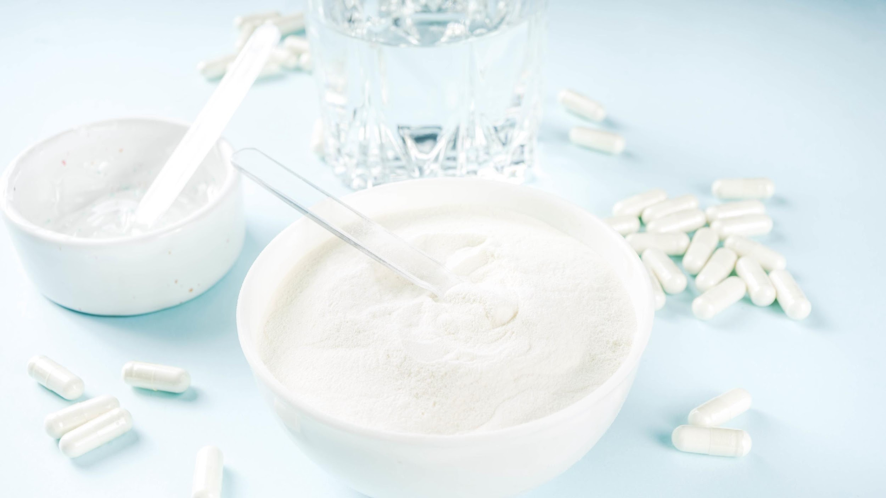

Consumer Insight Reports
Powered by Industry Transparency Center

Slide 10

HEALTH CONCERNS AND WHAT THEY TAKE SUPPLEMENT FOR (1st 10) ALL
Key Insights:
If we evaluate the gap (white space) between those currently consuming versus those willing to address a concern by consuming supplements, we find room for anxiety or stress, hair loss, joint or other pain, insomnia/sleep problems, mood and fatigue/tiredness. If we examine the gap between those willing to consume for a concern and all those with a concern, we see an education gap—specifically for anxiety or stress, skin health, digestive complaints, general health, hair loss, insomnia/sleep problems, mood and fatigue/tiredness.
Note: n=2435. Results shown top 10 health concerns. Health Concerns Question: “Which of the following health conditions or concerns currently impact or impacted you within the past year?”

Slide 11
ATTRIBUTES INFLUENCING PURCHASE: US, AGE & GENDER
Key Insight:
The health care professional response is quite strong in the US, and is the top response among females 55+ and males 26-34.
Natural source shows a strong response from females 26-34 and males 18-25 and 55+, while not genetically modified has a high response from both females and males 18-25.
Addressing my specific health concerns resonates most with older females and males 55+.
Note: US Female 18-25 n=33, US Male 18-25 n=46, US Female 26-34 n=78, US Male 26-34 n=82, US Female 35-44 n=78, US Male 35-44 n=103, US Female 45-54 n=66, US Male 45-54 n=48, US Female 55+ n=35, US Male 55+ n=19. Question: “What are the most important attributes you look for when purchasing supplements?”

Slide 12
BRANDED INGREDIENT VALUE PROPOSITION: US, 2021-2025
Key Insight:
In 2023 and 2024, we observed significant increases across the board, indicating that consumers are placing much more value on these qualities as part of the value proposition for branded ingredients. The response levels seen in 2024 have generally been maintained into 2025.
The branded ingredient logo on the front of the package continues to rise.
Note: 2021 US n=281, 2022 US n=405, 2023 US n=229, 2024 US n=177, 2025 US n=399. Question: “When deciding which supplements to purchase, how important are the following qualities/values related to any branded ingredient?” Percentage of responses marked “Extremely Important”

Slide 13
TRUST: US, AGE & GENDER
Key Insights:
Among US respondents, we see notable overrepresentation of females over 55 and those aged 45-54 when it comes to recommendations from a healthcare professional.
Consistent product quality strongly influences trust, especially for males 18-25 and males and females 26-34. Clinical research on the brand is particularly strong for females 18-25, 26-34 and males 55+. Clinical research on the ingredient is also a major driver.
Note: US Female 18-25 n=33, US Male 18-25 n=46, US Female 26-34 n=78, US Male 26-34 n=82, US Female 35-44 n=78, US Male 35-44 n=103, US Female 45-54 n=66, US Male 45-54 n=48, US Female 55+ n=35, US Male 55+ n=19. Question: “What characteristics most encourage you to trust a supplement brand?”

Slide 14
COLLAGEN LABEL CHARACTERISTICS: US, AGE & GENDER
Key Insights:
US results are very scattered. Just looking for collagen is high among males 26-34; collagen peptides tend to skew older. A good amino acid profile is common among younger males.
A values-based seal or certification is most popular among females 18-25, followed by males 35-44. Type II shows the strongest results for males 55+ and then males 35-44.
Note: US Female 18-25 n=17, US Male 18-25 n=19, US Female 26-34 n=50, US Male 26-34 n=34, US Female 35-44 n=54, US Male 35-44 n=49, US Female 45-54 n=42, US Male 45-54 n=23, US Female 55+ n=23, US Male 55+ n=16. Question: “When you select what Collagen to purchase, what characteristics do you look for on the label?”

Slide 15
PREFERRED SOURCE OF COLLAGEN: US, AGE & GENDER
Key Insight:
In the US, males predominantly select for chicken collagen consumption, especially those 35-44, followed by 18-25, then 26-34 and 45-54. Females are less likely to pay attention to the source, especially those 18-25 and 55+.
For marine, the top response also comes from males 18-25 and overall tends to skew male. Combination formulas are more sought after than in the global data.
Note: US Female 18-25 n=17, US Male 18-25 n=19, US Female 26-34 n=50, US Male 26-34 n=34, US Female 35-44 n=54, US Male 35-44 n=49, US Female 45-54 n=42, US Male 45-54 n=23, US Female 55+ n=23, US Male 55+ n=16. Question: “When you select what Collagen to purchase, what source(s) of collagen do you look for?”

Slide 16
VEGETARIAN COLLAGEN: US, 2023-2025
Key Insight:
The collagen source labeled as vegetarian rose sharply year over year.
Note: 2023 US n=90, 2024 US n=72, 2025 US n=68. Question: “You selected that you prefer a vegetarian source collagen in the previous question. Can you please share more information about what you look for when choosing your vegetarian collagen?”

Slide 17
COLLAGEN USAGE DRIVERS: US, AGE & GENDER
Key Insight:
In the US, a recommendation from a health care professional is the top response for most groups, especially those 45-54 and 55+, as well as males 18-25 and females 35-44. More information on benefits is a strong response from males 35-44, those over 55 and females 45-54.
Note: US Female 18-25 n=17, US Male 18-25 n=19, US Female 26-34 n=50, US Male 26-34 n=34, US Female 35-44 n=54, US Male 35-44 n=49, US Female 45-54 n=42, US Male 45-54 n=23, US Female 55+ n=23, US Male 55+ n=16. Question: “What would cause you start taking or take more collagen?”

Slide 18



Contact Us
Len Monheit
CEO, Industry Transparency Center
len@itcstrategy.com
Steve Imgrund
Communications Director, CSA
len@itcstrategy.com
@collagenstewardshipalliance
collagenalliance.org

